Slide 1
Initial Project Presentation
Chad Madding
Shane Weinstock

Slide 2


Identify yourself and your team
Shane Weinstock
Chad Madding
3-minute YouTube video: (You can use the same slides, but each team member must make the full presentation with all the slides.)

Slide 3
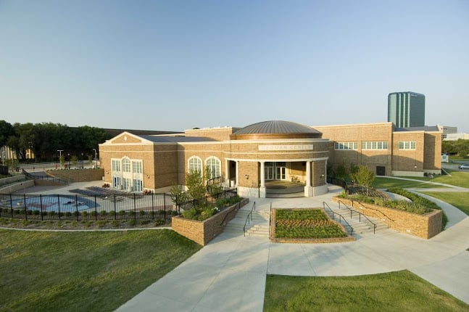
Describe Data Set / Time Series
What: The data is from a turnstile at the Dedman Center for Lifetime Sports on the Southern Methodist University campus.
Who
What
When
Where
Why
How
Why: Forecast usage for student staffing needs.

Slide 4
Stationary / Non-Stationary

Slide 5
ACFs and Spectral Densities just to explore

Slide 6
At least 2 candidate ARMA / ARIMA models
The models in factored form with standard deviation
AIC
ASE
Visualization of Forecasts with a Practical Horizon.

Slide 7
Strategy / Plans for the rest of the analysis
Submit your slides to 2DS and make sure your video URL is on the Google Doc.

